Slide 1
Introduction to Machine Learning
By: Abhijith Neil Abraham, AI Engineer at Aecmaster
Event: GDSC WOW at Rajagiri School of Engineering, Kakkanad

Slide 2
Agenda
-Brief Overview of AI and ML
-Introduction to Large Language Models (LLMs)
-Advances in Computer Vision
- Promising Applications and Future Trends
- Q&A

Slide 3
Brief overview of AI, ML and Deep Learning
Artificial Intelligence (AI): Branch of computer science aimed at creating machines that can perform tasks requiring human-like intelligence
Machine Learning (ML): Subset of AI that focuses on creating algorithms that learn from data
Deep Learning: Subfield of ML using artificial neural networks to model complex patterns in data

Slide 4
Introduction to neural networks
Inspired by the human brain's structure and function
Composed of interconnected neurons organized in layers
Process and learn patterns in data through weights and activation functions
Deep Learning: Neural networks with multiple hidden layers
Applications: Image recognition, natural language processing, speech recognition, and more

Slide 5
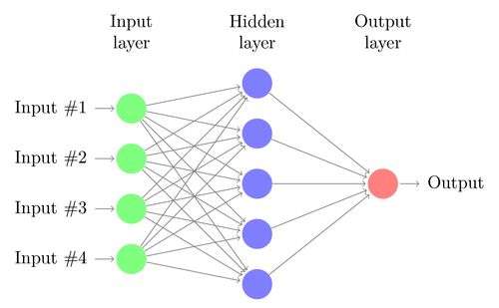

Slide 6
Training a Machine Learning Model
Data Collection: Gather relevant data for the task
Preprocessing: Clean, normalize, and transform data
Feature Engineering: Extract meaningful features
Model Selection: Choose appropriate algorithm
Model Training: Optimize model parameters
Model Evaluation: Assess performance using metrics
Model Tuning: Fine-tune hyperparameters for optimal results
Deployment: Integrate trained model into applications

Slide 7
Common Tasks Solved in Machine Learning
The common tasks solved in machine learning can be categorized into:
Supervised Learning Tasks
Unsupervised Learning Tasks
Reinforcement Learning Tasks

Slide 8
Supervised Learning
Supervised learning: The algorithm is trained on a labeled dataset, where input features and corresponding output labels are provided, with the goal of learning a mapping from inputs to outputs that can be generalized to new, unseen data.

Slide 9
Supervised Learning Tasks
Classification: Categorizing data into discrete classes
Examples: Email spam detection, image classification
Regression: Predicting a continuous value based on input features.
Examples: House price prediction, stock market forecasting, energy consumption estimation

Slide 10
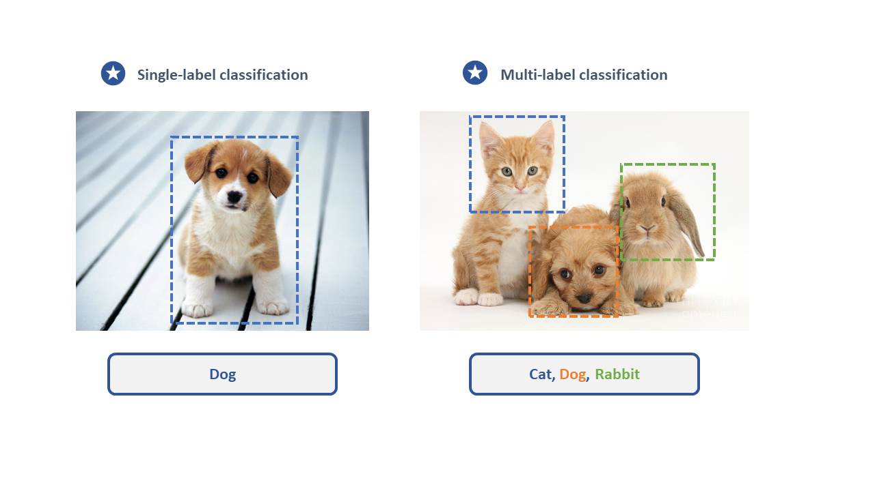

Slide 11
Unsupervised Learning
Unsupervised learning: The algorithm processes an unlabeled dataset to discover patterns, relationships, or structures within the data itself, without prior knowledge of output labels, often used for tasks such as clustering or dimensionality reduction.

Slide 12
Unsupervised Learning Tasks
Clustering: Grouping similar data points together without prior knowledge of classes
Examples: Customer segmentation, anomaly detection, gene expression analysis
Dimensionality Reduction: Reducing the number of features in a dataset while preserving important information
Examples: Data visualization, noise reduction, feature extraction

Slide 13
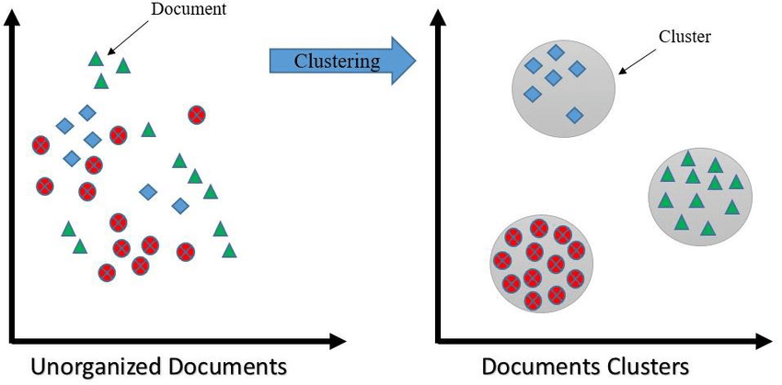
Notes:
Note that we haven’t labelled any clusters.

Slide 14
Reinforcement Learning
Reinforcement learning: The algorithm learns to make decisions by interacting with an environment, receiving feedback in the form of rewards or penalties, and iteratively updating its actions or policies to maximize cumulative rewards over time.

Slide 15


Slide 17
Recent Developments and underlying technologies
Most popular recent developments that the AI community is currently talking about:
LLMs and LLM powered apps like ChatGPT
Image generation APIs like Midjourney , Dall-E and Stable Diffusion.

Slide 18
Natural Language Processing (NLP)
Subfield of AI that enables the machines to understand human language
Vectorises the natural language input into numerical terms. These vectors are called embeddings.
The embeddings are more easier for the machine to understand.

Slide 19
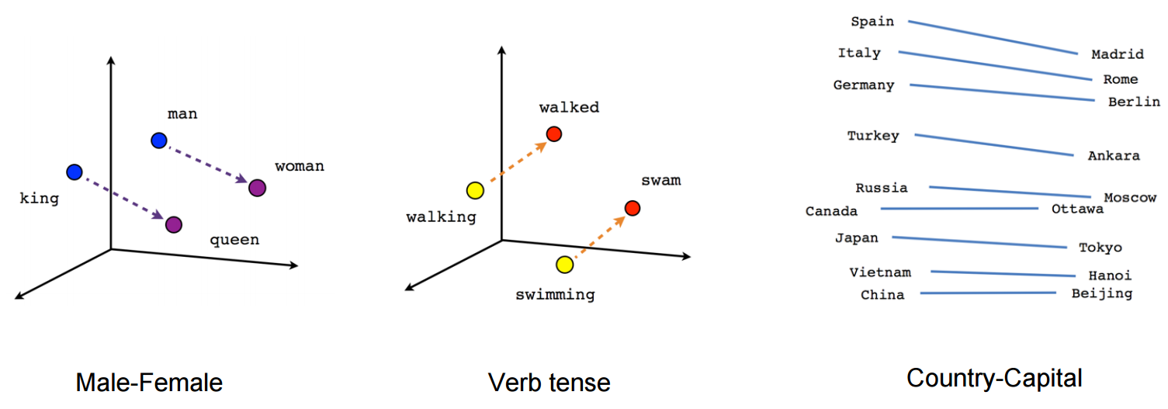

Slide 20
LLMs(Large Language Models)
Large Language Models (LLMs) are advanced artificial intelligence systems designed to understand and generate human language. They are trained on massive amounts of text data from various sources, like websites, books, and articles. These are the models that power applications like ChatGPT.
Example : GPT-3, GPT-4, LaMDA, BLOOM, and LLaMA

Slide 21
GAN( Generative Adversarial Networks)
GANs can generate new data samples that does not pre-exist in the trained data.
The generator takes random noise as input, which ensures that the generated samples will have some degree of randomness and variation. This randomness helps create diverse samples that don't exactly match the training data.
GANs have been particularly successful in image generation tasks due to their ability to capture and reproduce the underlying structure and patterns in image data.

Slide 22
Generating images with help of text
Models like Dall-E help in generating images from prompts.
The text and image, both are converted into embeddings and trained.

Slide 23
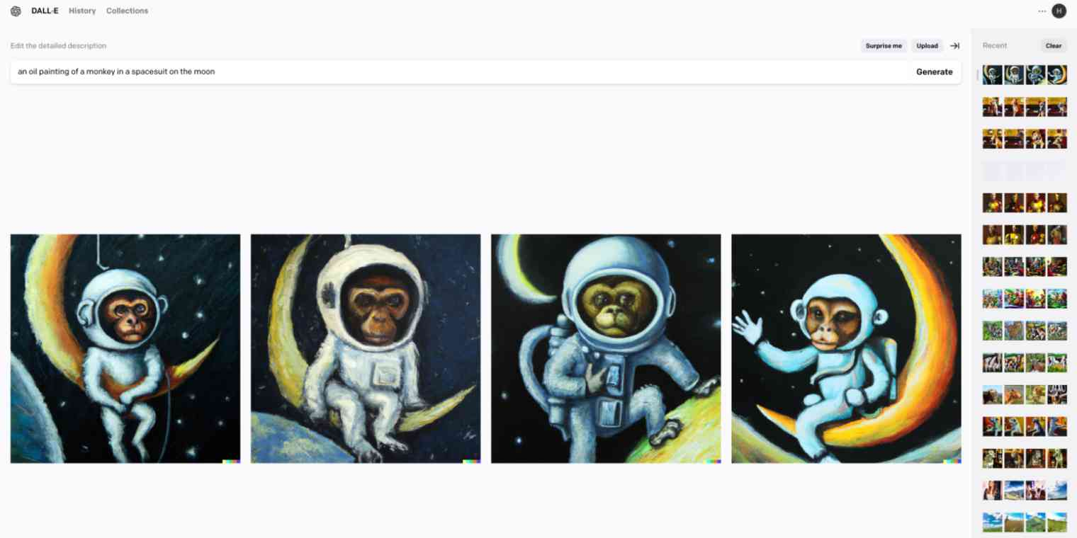
Notes:
An oil painting of a monkey in a space suit on the moon

Slide 24
Applications
There are numerous applications for ML across various industries. A few examples:
Healthcare
Diagnostics: Image classification using Convolutional Neural Networks (CNNs)
Drug discovery: Unsupervised learning techniques for clustering and dimensionality reduction

Slide 25
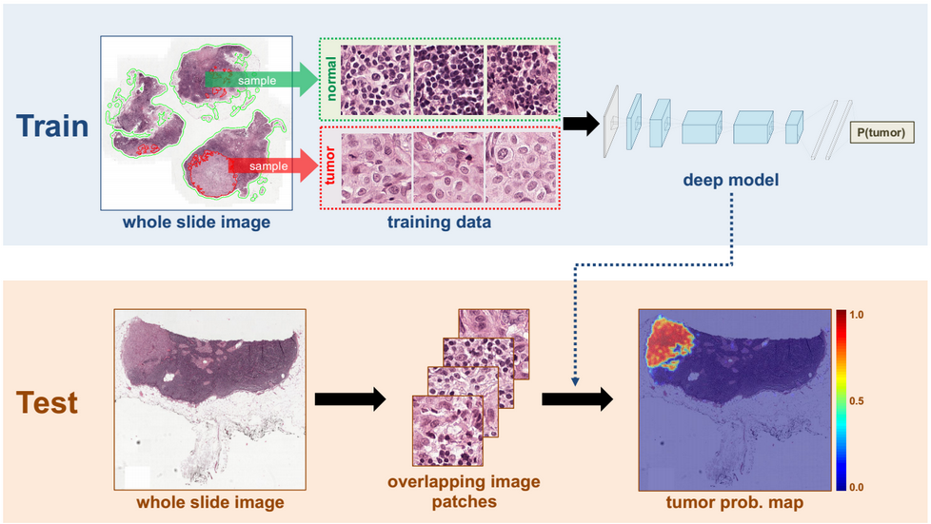

Slide 26
Applications (Contd.)
Finance
Fraud detection: Anomaly detection using clustering algorithms
Algorithmic trading: Time series forecasting with Recurrent Neural Networks (RNNs)

Slide 27
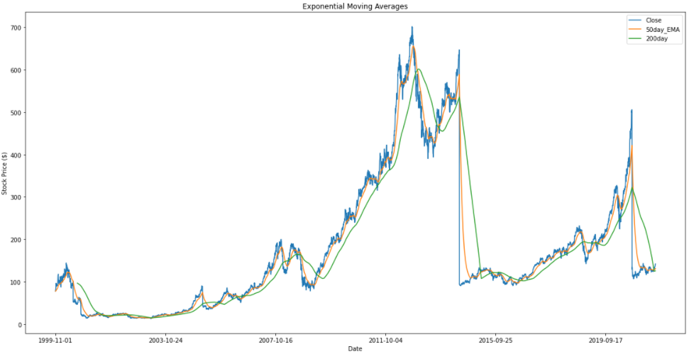

Slide 28
Applications (Contd)
Marketing and Retail
Customer segmentation: Clustering techniques like K-means
Product recommendation: Collaborative filtering for personalized suggestions

Slide 29
Applications (Contd.)
Autonomous Vehicles and Robotics
Self-driving cars: Reinforcement learning for decision-making
Drones: CNNs for object detection and avoidance

Slide 30
THANK YOU!

